Slide 1
Battle of the Neighborhoods
By Rohin Sharma

Slide 2
Introduction
This project aims to compare two cities: Toronto and New York. New York is located in the United States of America while Toronto is located in Canada.
Both cities are densely populated therefore they entertains a large amount of crowd every day.
This project will compare in terms of number of venues present in city’s borough to check which city has more variety of borough as well as in large numbers.
This will give an overview that which city will provide services to its population better.

Slide 3
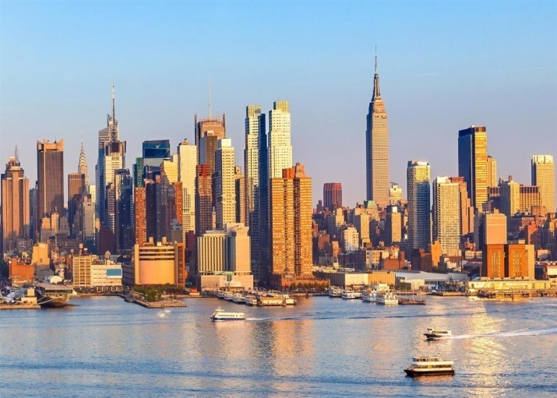
New York
It is located at the southern tip of the state of New York.
It is the largest metropolitan area in the world by urban landmass.
New York City consists of five boroughs, each of which is a separate county of the State of New York.
New York is the most populous city of United States, hence it carters to large amount of people.
In 2017, the city had an estimated population density of 28,491 inhabitants per square mile, rendering it the most densely populated of all municipalities housing over 100,000 residents in the United States

Slide 4
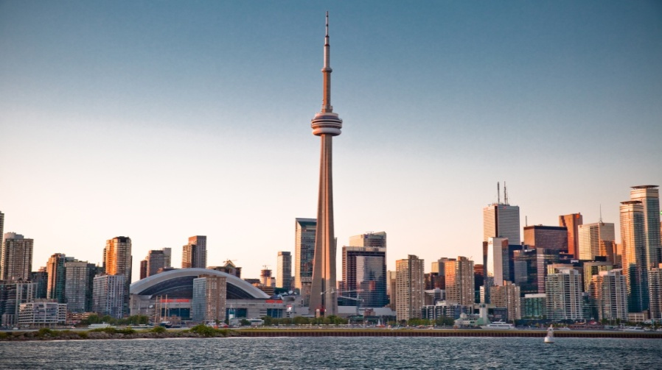
Toronto
Toronto is the provincial capital of Ontario, and the fourth largest populous city in North America, with a population of 2,731,571 as of 2016.
Toronto is the most populous city of Canada which carters to variety of people.
Toronto encompasses a geographical area formerly administered by many separate municipalities.
Toronto is an international centre of business, finance, arts, and culture, and is recognized as one of the most multicultural and cosmopolitan cities in the world

Slide 5
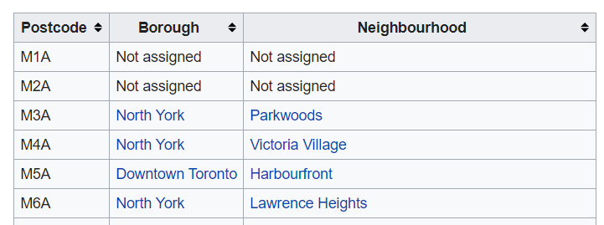
Toronto Dataset
The dataset for Toronto is scrapped from Wikipedia page and it is stored in the dataframe. The dataset contains three columns namely postcode, borough and neighborhood. It has 288 rows with raw data which is refined by removing unassigned borough which leaves only 102 rows for further processing.

Slide 6
New York Dataset
New York dataset is taken from New York University Website. This dataset has a total of 5 boroughs and 306 neighborhoods. In order to segment the neighborhoods and explore them, we will essentially need a dataset that contains the 5 boroughs and the neighborhoods that exist in each borough as well as the latitude and longitude coordinates of each neighborhood.

Slide 7
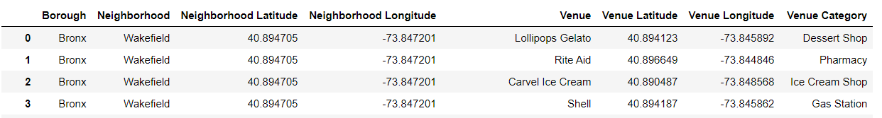
Data Cleaning
Both dataset were cleaned for working on them efficiently. First the entire boroughs with not assigned values were dropped from the dataset.
The neighborhood having unassigned values were replaced with their respective borough values.
Neighborhood having same borough had their values merged into single row, so that it was simpler to work by taking borough as the center feature.
Foursquare API was used to gather data about venues in the borough. Data for venues which within 500 meter radius were collected by the API and it was joined with the original dataset.

Slide 8
Methodology
To gather information how venues are distributed and which are the top venues of the area, one hot encoding was done on the dataset.
Mean value of the distributed venues were taken to get their frequency in the borough and understand how they were scattered across the venue.
Frequency were mapped to their respective venue category and sorted in the ascending order of their availability in the borough.
K-Means was used in this project to define cluster for the dataset.

Slide 9
K-Means
K-means is one of the simplest unsupervised learning algorithms that solve the well known clustering problem.
The main idea is to define k centers, one for each cluster. These centers should be placed in cunning way because of different location causes different result.
It provides well defined results which are distinctly separated from each other. K-Means was used in this project to define cluster for the dataset.
The clusters were mapped on the map to get the desired output and visualization of the result.

Slide 10
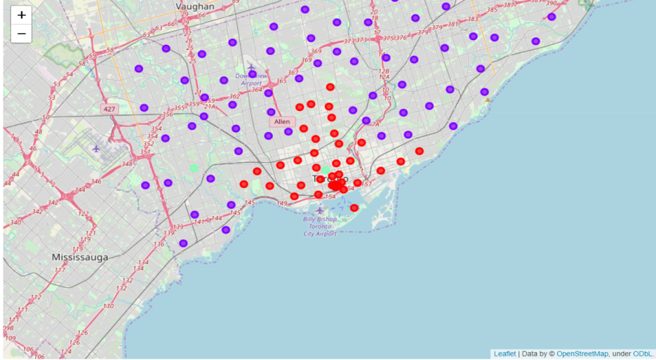
Results
Toronto Cluster 0: It was concentrated which means that venues are located closely and they are in lesser quantity compared to other cluster. It has Coffee shops as the most common venue among them and other venues are variable.
Toronto Cluster 1: It was scattered across the map but it consisted more venues than cluster 0. It has park as the most common venue for the cluster.

Slide 11
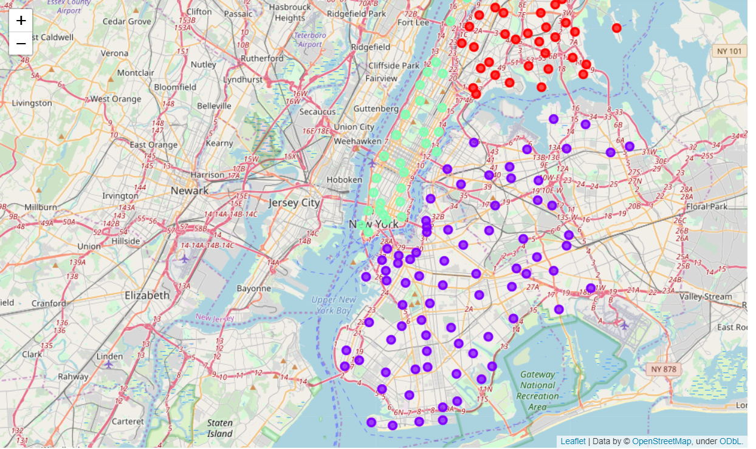
New York Cluster 0: It is smallest cluster among the three clusters and it has Pizza Place and Bodega as the two most common venues among borough.
New York Cluster 1: It is evenly distributed across map and it has more boroughs than cluster 0. It has coffee shops as the most common venue.
New York Cluster 2: It was the biggest cluster among the three clusters. It also has Pizza place as the most common venue but Bakery is the second most common venue unlike cluster 0.

Slide 12
Conclusion
From results, we can conclude that New York has more variety of venues in greater quantity than Toronto.
While Pizza place has been common venue in the New York which is present in large quantity and closely located to each other. This suggests that Pizza is the one of the favorite food for the people in New York.
In Toronto, Coffee place has been the most common place which is suggested by the cluster and it is seconded by the park in the neighborhoods.
This can be better researched and explained by using other features for the dataset like using venue ratings which will provide better overview.

